Slide 1
Manual for the DC Power Supply
EE405(B) Lab session
2023.03.27.

Slide 2
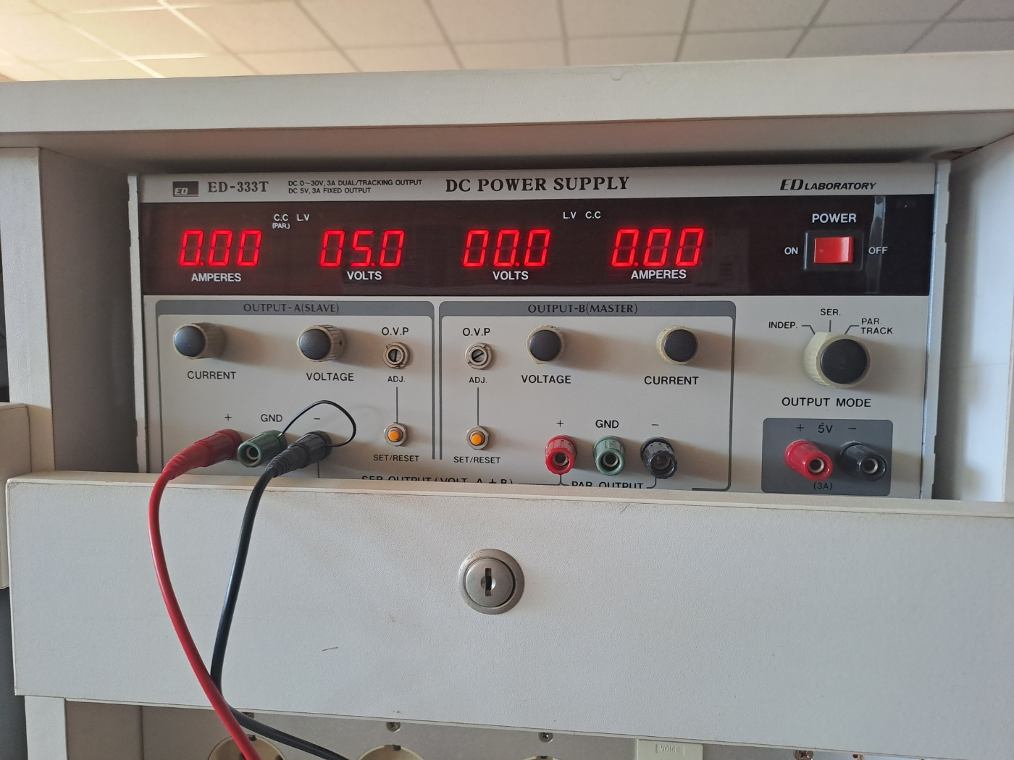
DC Power Supply you will use: ED-333T
Power Switch
Digital Voltage meter
Output Mode Switch
Digital Ampere meter
Output port
Over Voltage Protection

Slide 3
DC Power Supply manual
1) Turn the Voltage meter switch to the CCW end / Ampere meter switch to the CW end.
2) Check if Output Mode Switch set as ‘INDEP’.
3) Turn on the power switch.
4) Set over voltage protection value to the slightly higher than the desired voltage value.
5) Connect GND & (-) port of the DC power supply using jumper wire.
6) Connect (+)/(-) port to your electric circuit using wire clamp.
** Turning off the DC power supply is recommended when not in use.

Slide 4
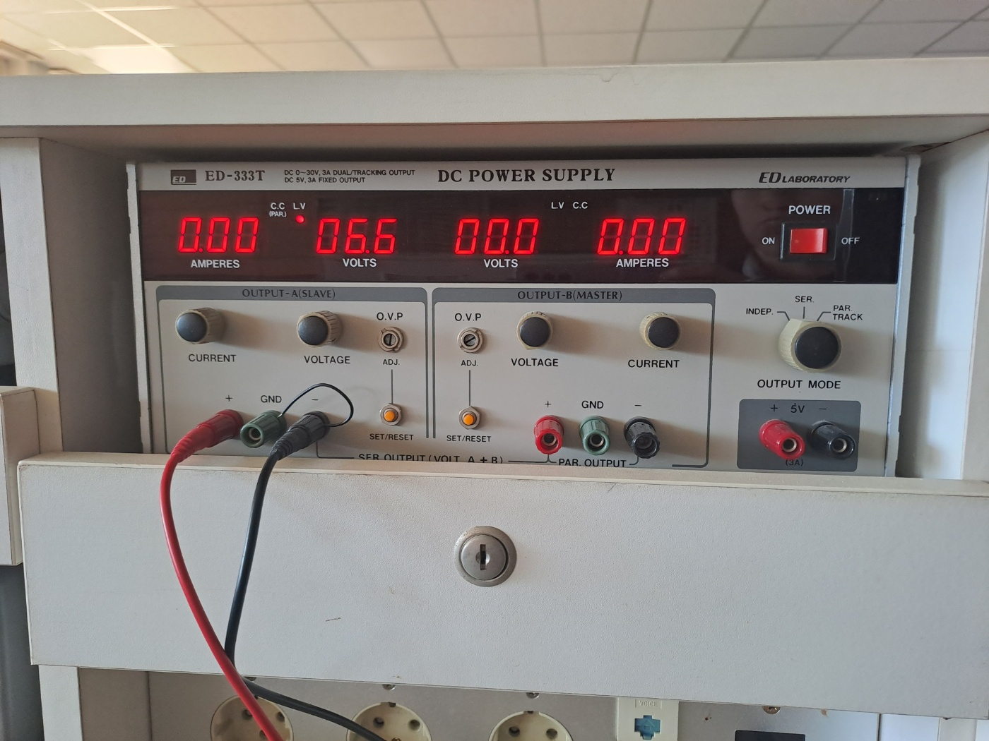
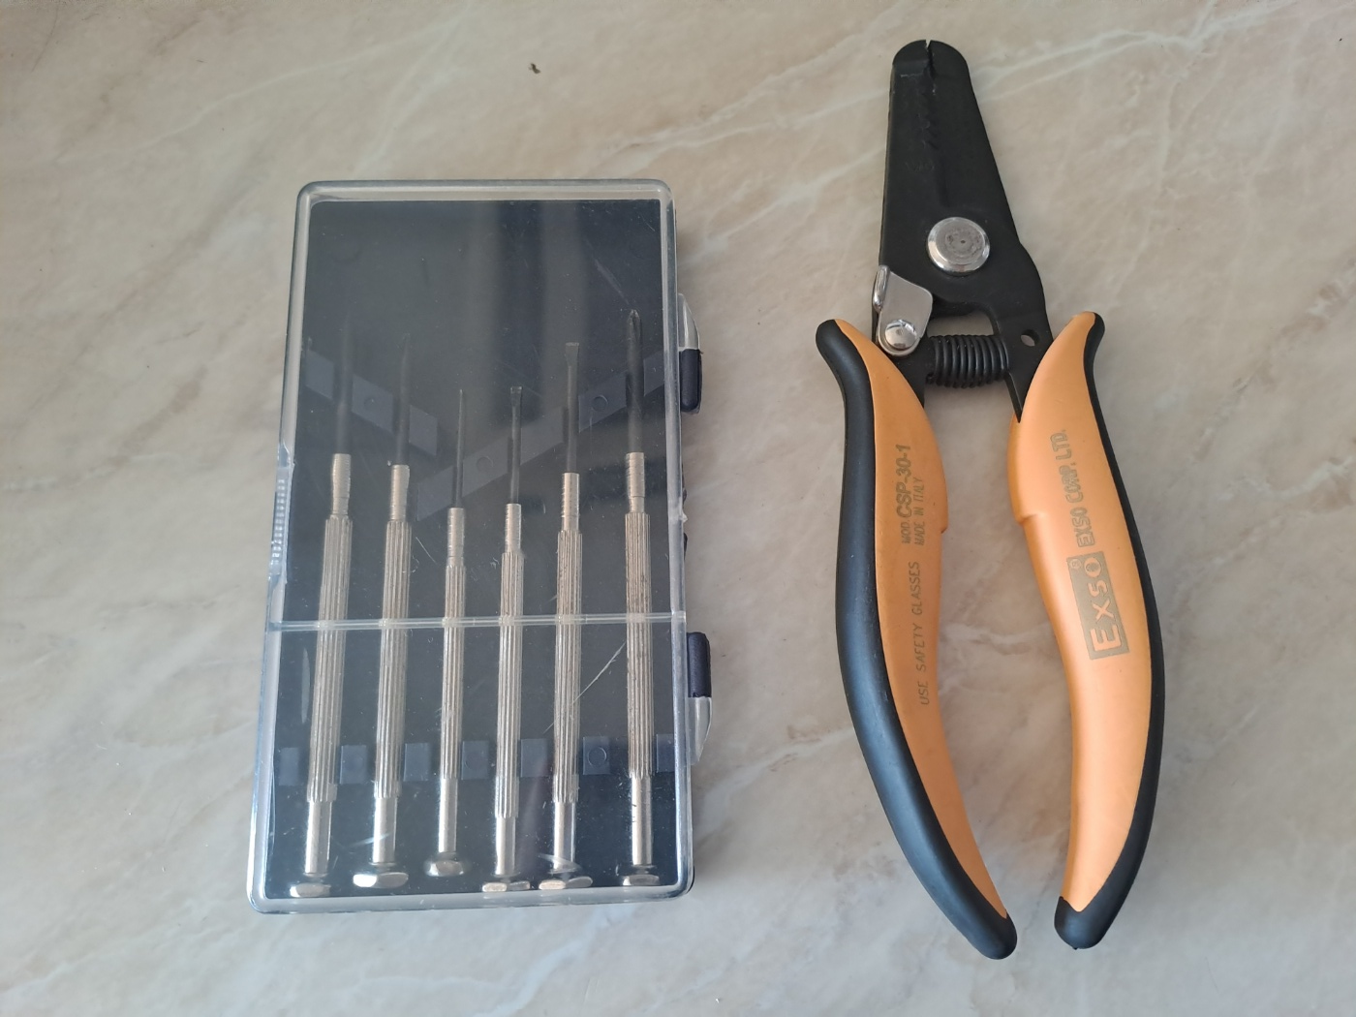
** How to change over voltage protection value?
To change O.V.P. value,
Keep pushing SET/RESET button
rotate ADJ. to modify O.V.P. value
** Use flat-head screwdriver to rotate it.
Over Voltage Protection

Slide 5
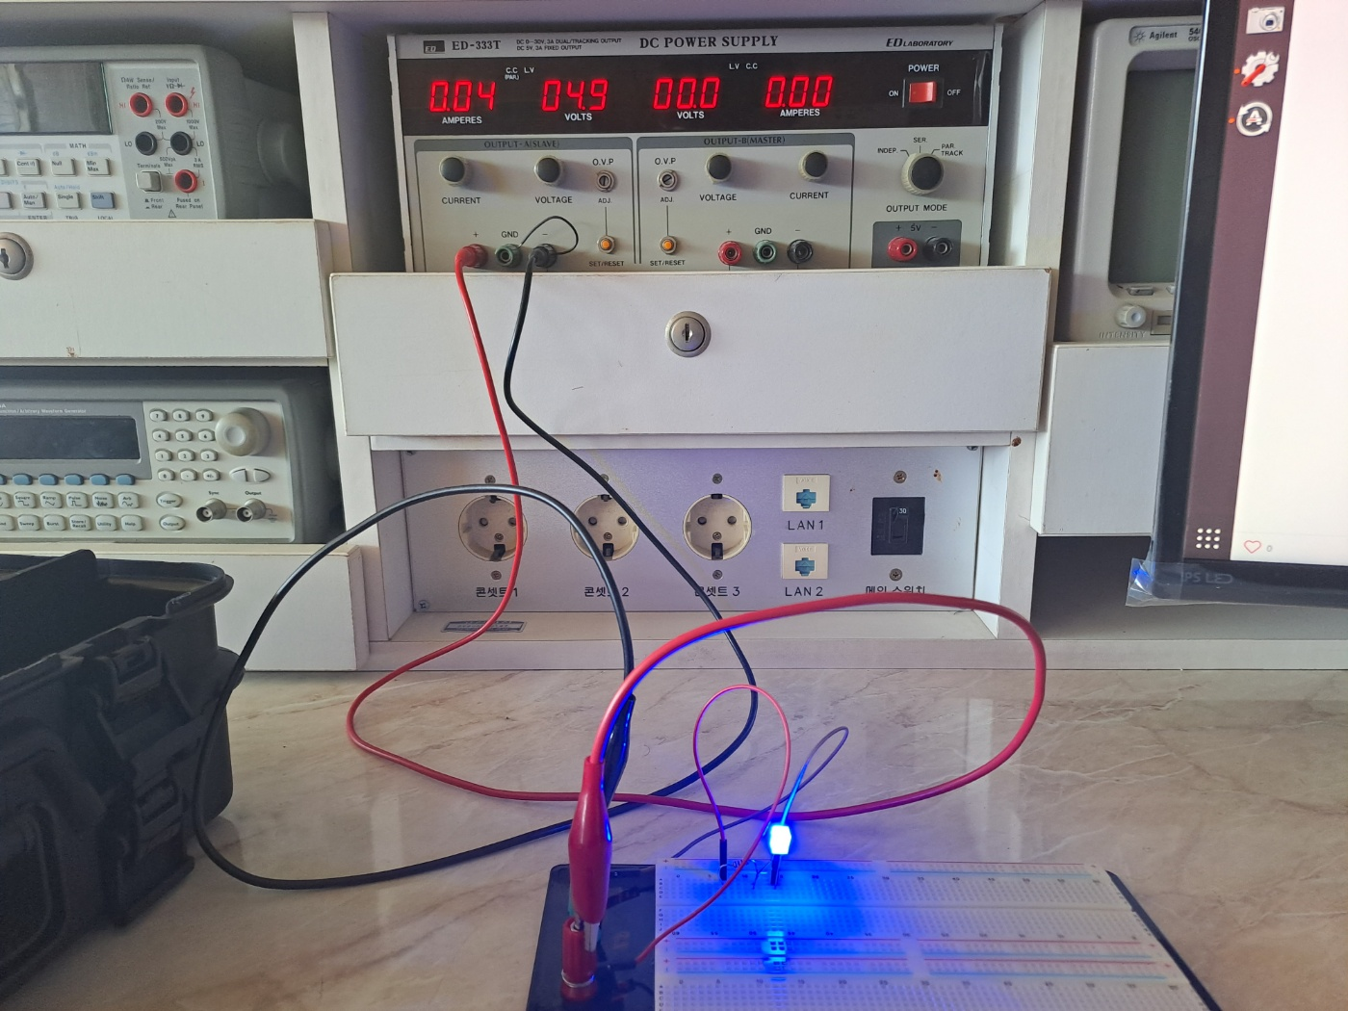
Connection between electric circuit
Example LED circuit using DC power supply
Enjoy your lab session :)

